Slide 1

VE496 Advanced Technical Communication
Week 1:
Problem Definition and Problem-Need Solution Analysis
Nathaniel T. Murray 莫子禅
Summer 2020

Slide 2
Plan for today
Course objectives and policies
Organization of a technical project
Problem definition and evaluation criteria
Problem-need-solution analysis

Slide 3
Opening Question
What challenges—economic, industrial, technological—do we face during recovery (复工复产) from the COVID-19 pandemic?

Slide 4

Who am I? 莫老师是谁?
Academic background
Ph.D. in Reading and Literacy, University of Florida (2019)
M.S. in International Relations, University of Edinburgh (2010)
B.A. in Music, College of the Holy Cross (2006)
Minor in Physics
Dissertation on the teaching of academic and scientific English writing in Chinese higher education settings
Teaching experience: five years teaching academic and business English in various cities in China (2010-2014, 2019-present)

Slide 5
Course Objectives
Strengthen students’ ability to define a technical problem through benchmarking and needs analysis
Develop students’ ability to report technical data in writing and a variety of visuals such as charts, graphs, tables, and diagrams
Improve students’ ability to properly cite and format graphics, equations, paragraphs, and references
Cultivate students’ presentation skills, particularly intonation, body language, and group interaction
Strengthen students’ command of the features and linguistic structures of technical language

Slide 6
Course Format
Workshop style
One-third of time: I lecture on new material
One-third of time: You work on writing exercises
One-third of time: I provide usable feedback and the chance to implement it
Flipped classroom
Out-of-class time is used for reading or watching lecture material
In-class time is spent on practice exercises
Intensive case studies and material related to capstone
Peer review

Slide 7
Course Policies
Attendance
Participation
Food and drink
Assignments
Electronic devices
Electronic security
Honor code

Slide 8
Your Responsibilities
Attend every class, log in on time
Participate actively during class and on all assignments
Communicate with me about your writing needs (otherwise I won’t know how to help you)

Slide 9
My Responsibilities
Provide you with ample opportunities for writing practice
Give you clear guidelines on how each assignment will be graded
Provide feedback and material that are directly applicable to your needs (but I can only do that if I know what those needs are)

Slide 10
JI Students: Common Areas of Struggle
Differentiating between problems, needs, and solutions
Defining the problem, and making sure the purpose and solutions logically follow from it
Converting qualitative customer requirements into quantitative technical specifications
Purpose and structure of a literature review
Writing with appropriate tone: abstracted and de-personalized
Weak evidence and one-sentence paragraphs
PPT slide formatting: content, layout, sponsor logo

Slide 11
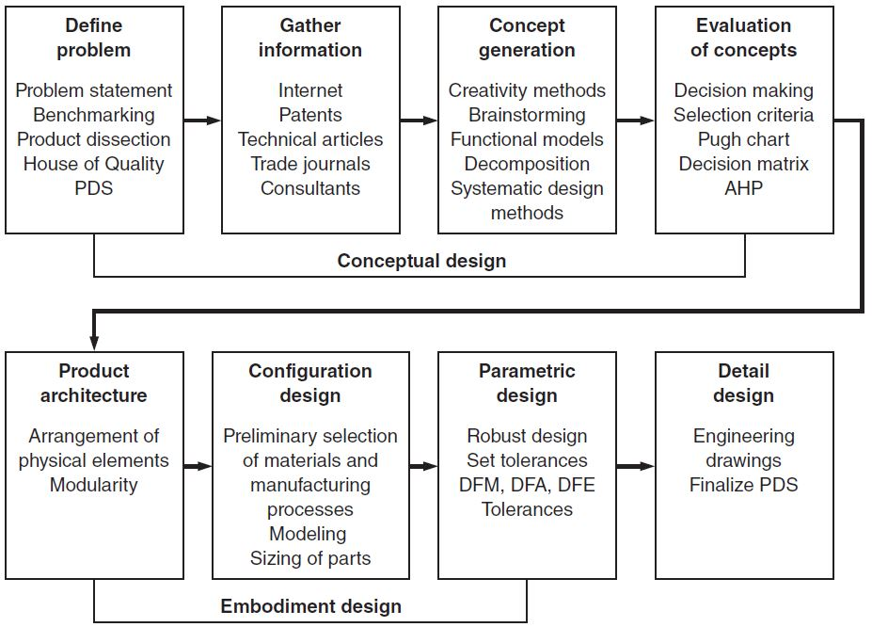
Engineering Design Process
Source: Dieter & Schmidt (2013), p. 15

Slide 12
Technical Project Design
Criteria | The categories by which the problem will be assessed
Problem | The shortcomings (impact on people) of existing devices, as assessed by the criteria
Need | The things that are required in order to fix the problem – the general “what”
Solution | The way in which those needs will be met – the specific “how”
Remember: Every need and solution must be directly tied to a criterion established in the problem section

Slide 13
Example: Spring-Loaded Mousetrap
“Our environment is infested with mice, but we do not have enough electrical power for an electronic solution.”

Slide 14
Example: Spring-Loaded Mousetrap
Criteria
Needs
Number of mice
Power consumption
Eliminate the mice
Must not consume any electrical power
Problems
Solutions
Infestation of mice
Mice carry disease
No electrical power available for any solution
Bait lure, mouse-triggered, passive spring-loaded trap which captures or kills the mice

Slide 15
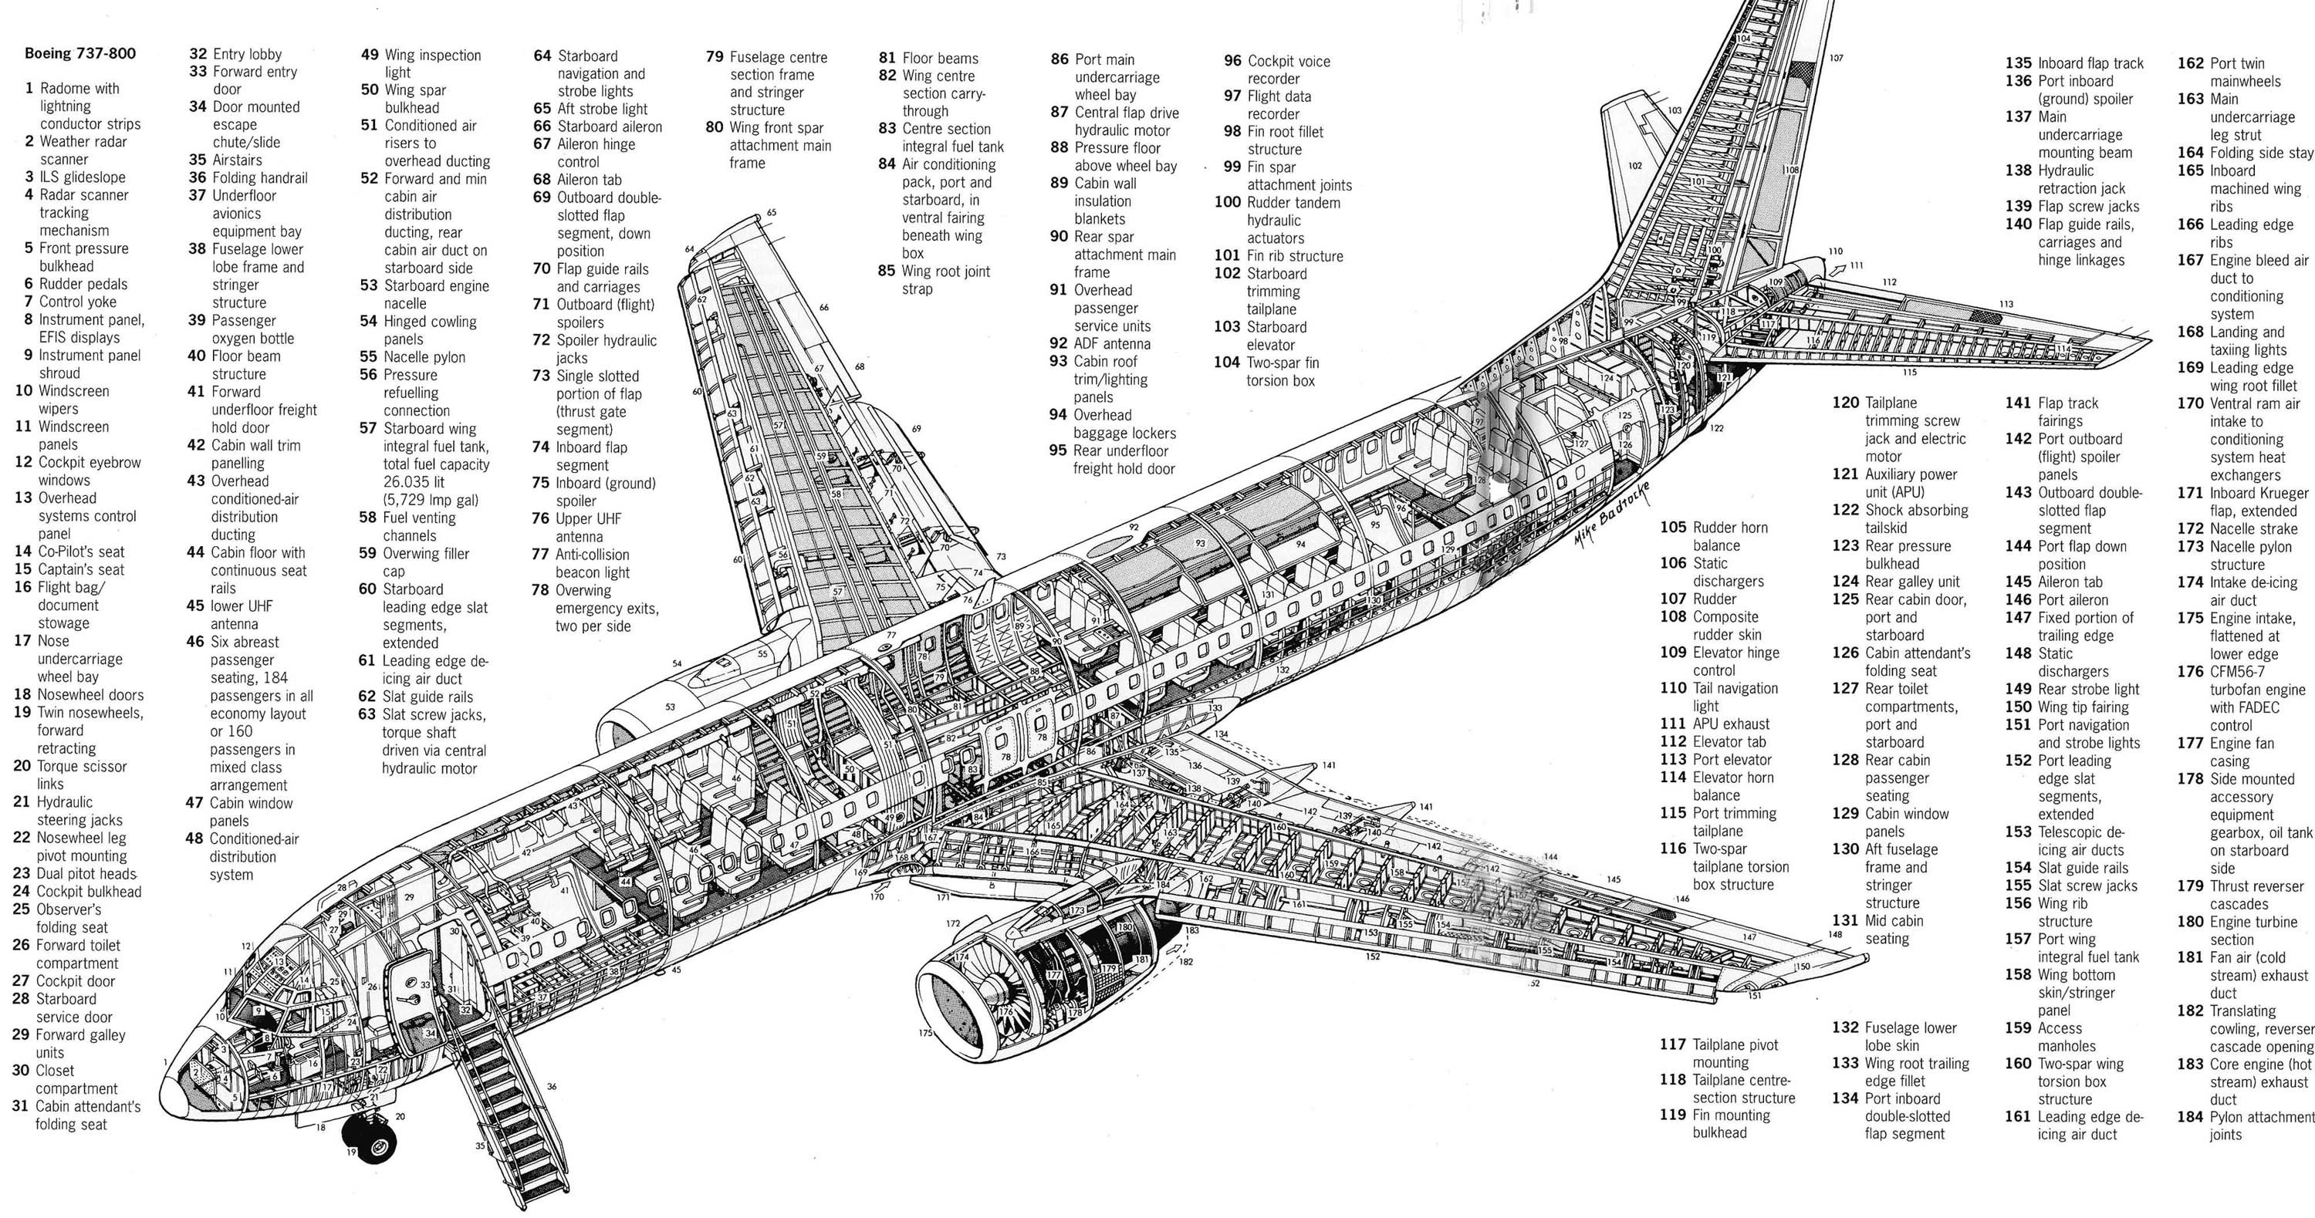
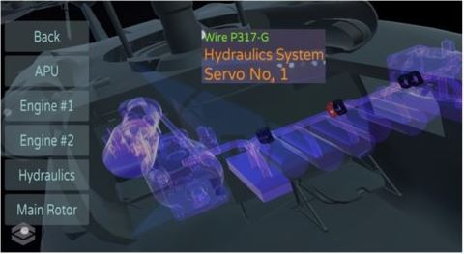
Example: Aircraft Wiring Maintenance
Criteria
Needs
Frequency of fault detection
Frequency of repetitive strain injuries
Must increase detection of faults in aircraft wiring
Must reduce frequency of repetitive strain injuries
Problems
Solutions
Manual inspection of wear and tear in aircraft wiring can overlook small, hard-to-see faults, while increasing risk of repetitive strain injury
Smart interconnecting clamp (ICC) system with embedded sensors to read voltage and amperage flow in aircraft wiring, with augmented reality monitoring system (ARMS) to visualize fault locations
, reducing the need for manual inspection of wires
Source: https://www.ncms.org/directory/united-aircraft-technologies-inc/

Slide 16
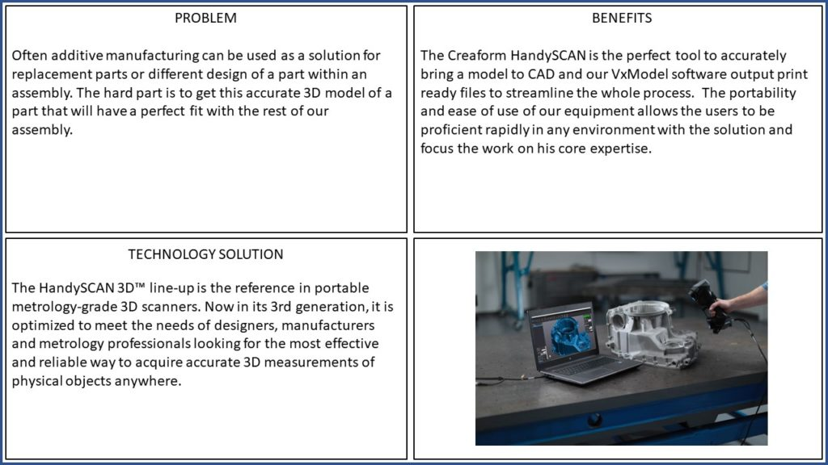
Quad Chart Sample #1
Source: https://www.ncms.org/directory/creaform/

Slide 17
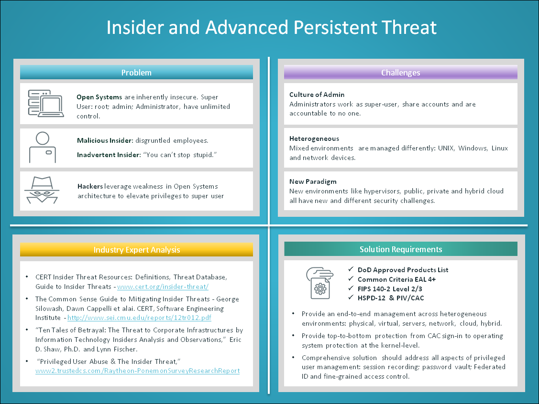
Quad Chart Sample #2
Source: https://governmenttechnologyinsider.com/simple-rule-decision-making-bold-brief-gone/

Slide 18
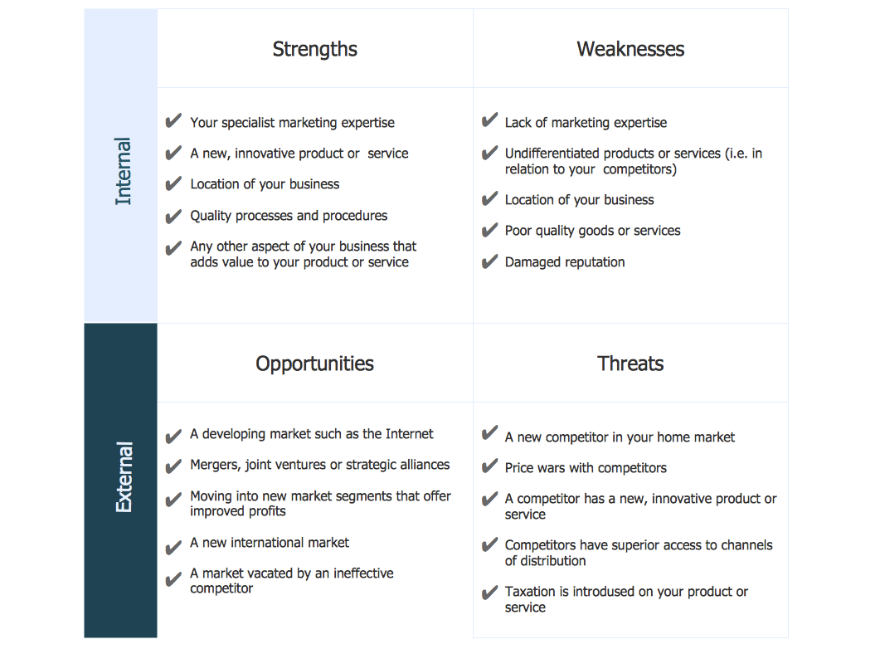
Quad Chart Sample #3
https://www.conceptdraw.com/examples/swot-analysis-of-a-software-company

Slide 19

Practice Exercise
Choose a simple, common tool or device that you would like to improve upon
Identify the categories/criteria by which you will evaluate the device
Specify existing problems with the device, according to the criteria
Determine the needs required to improve the device, according to the criteria
Identify potential solutions by which those needs could be met, guided by the criteria

